Slide 1


Slide 2
MobiJet
(Mobile in Budget)
(Mobile in Budget)

Slide 3
Project Name: MobiJet
Guided By : Rishi Sir
Group No: 01
Submitted By :
Amit Nehete 220960520007
Abhinav Tongale 220960520002
Khileshwari Firake 220960520026
Yatish Chaudhari 220960520090
Ajinkya Survase 220960520005
Aniket Shingne 220960520010

Slide 4
Agenda:-
1. Project Introduction
2. Project Architecture
3. Technology Platform used for Project
4. User Roles and responsibilities
5. Snapshots
6. Points to be Upgraded
7. Future Extension
8. Conclusion

Slide 5
Project Introduction:-
Purpose of the Project:
The purpose of MobiJet is to provide online platform of sale and purchase of mobiles in an efficient manner
Provide pickup and drop service for repairing and sell/buy products
Need:
There is no one who provide repairing service online
If customers want to buy mobile at affordable cost, then they are not getting quality product

Slide 6
Project Architecture:-
Used for:
User Interfacing
Basic Data Validation
Used for:
Server side validations
Response handling
Business Logic
Database operation
Used for:
Permanent Data storage
Database level validations
Database Access
Front End Layer
Server Layer
Database Layer
Technology used:
React JS
Technology used:
Spring-Boot
Technology used:
My SQL

Slide 7
User Roles and responsibilities:-
Roles
Customer
Service Provider
Admin
Responsibilities
Customer: search product, buy product, send request for repairing or selling
Service Provider: handling all request from customer, fill mobile detail of customer
Admin: Permissions for account authentication ,Remove Product’s

Slide 8
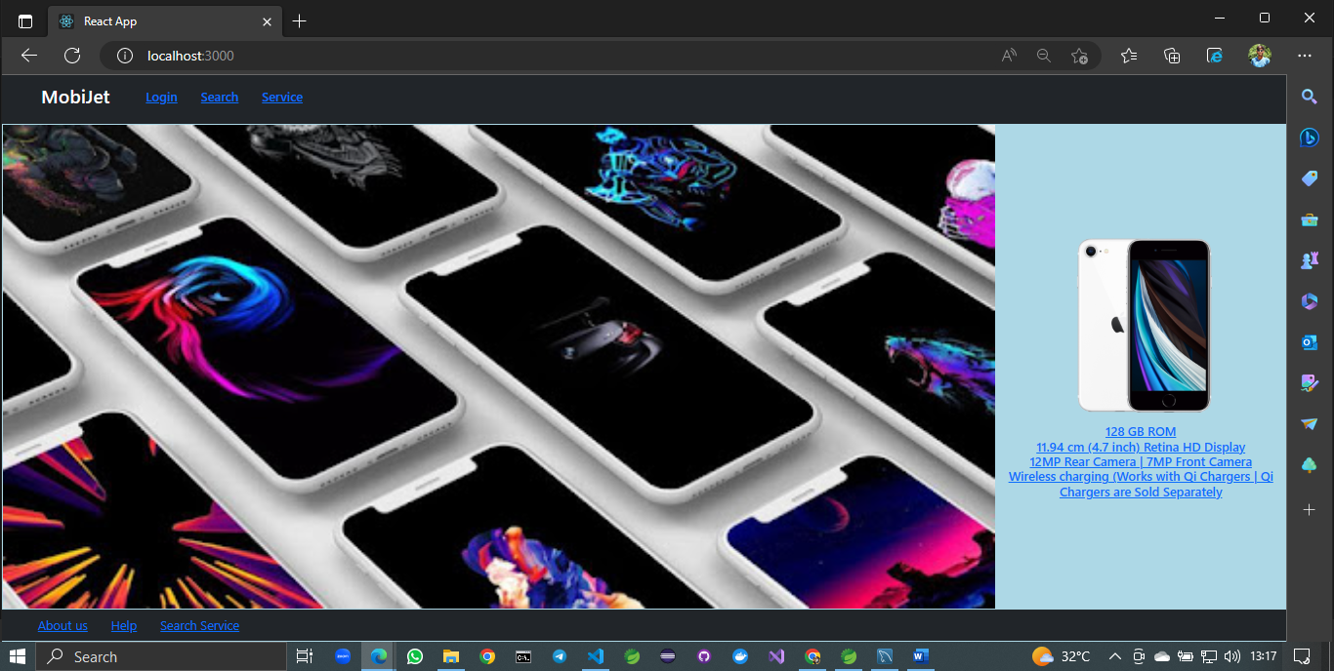
Home Page

Slide 9
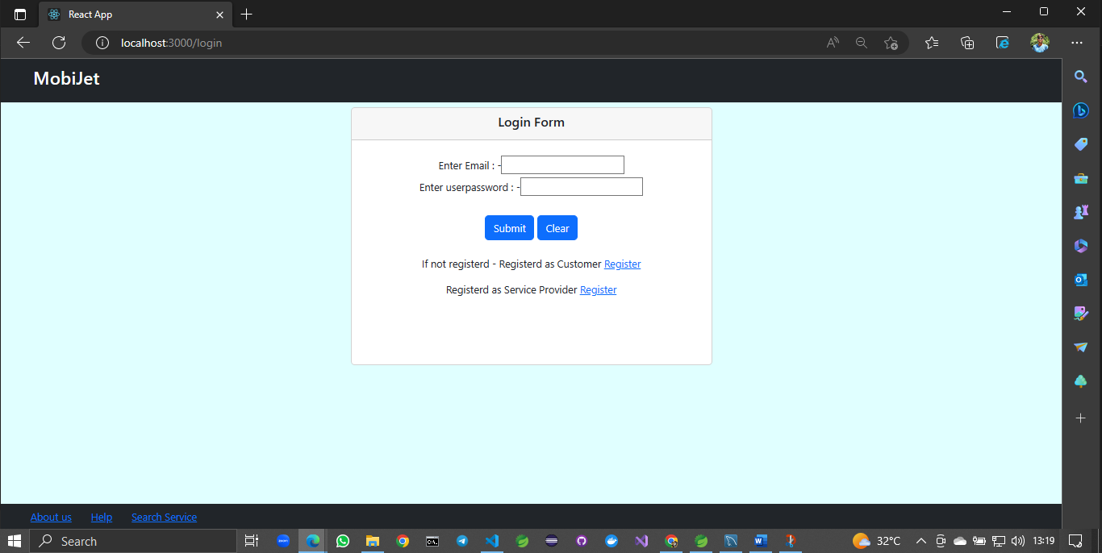
Login Form

Slide 10
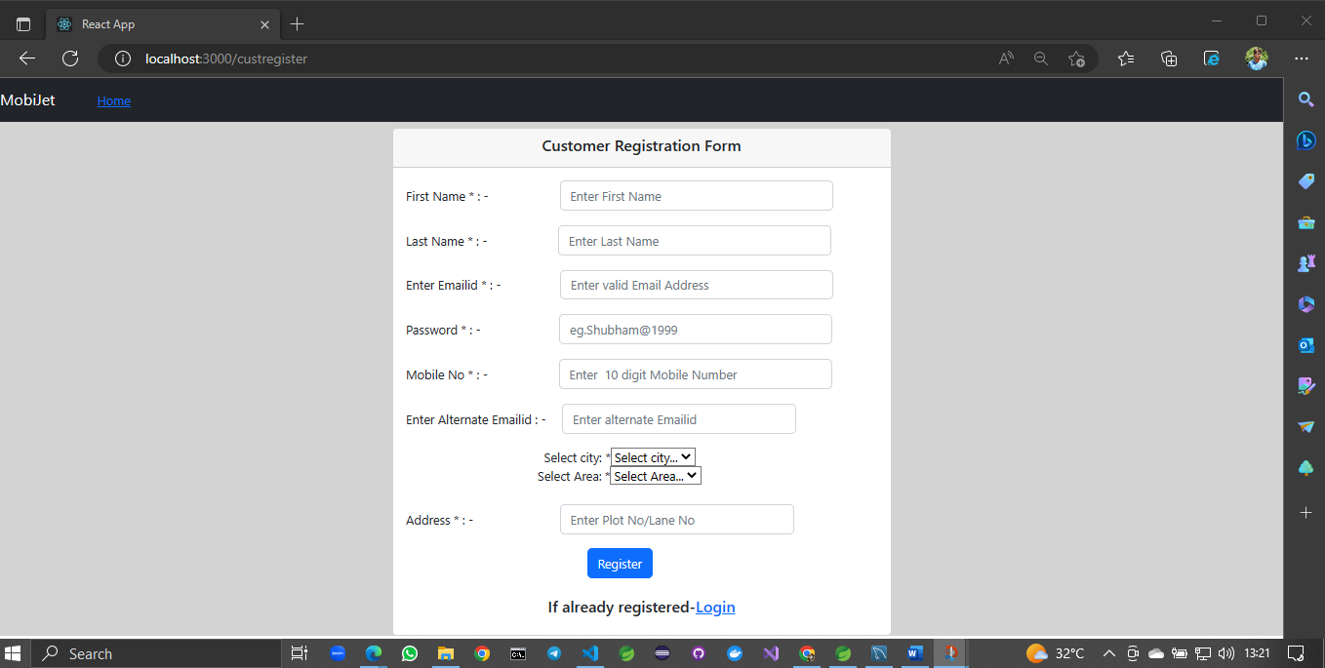
Coustomer Registration Form

Slide 11
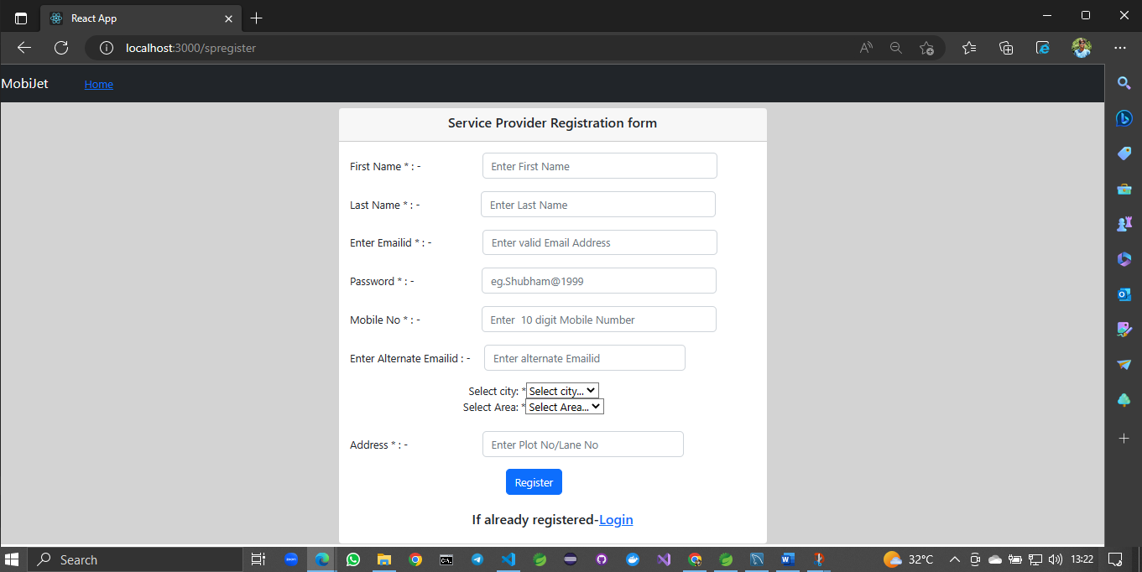
Service Provider Registration Form

Slide 12
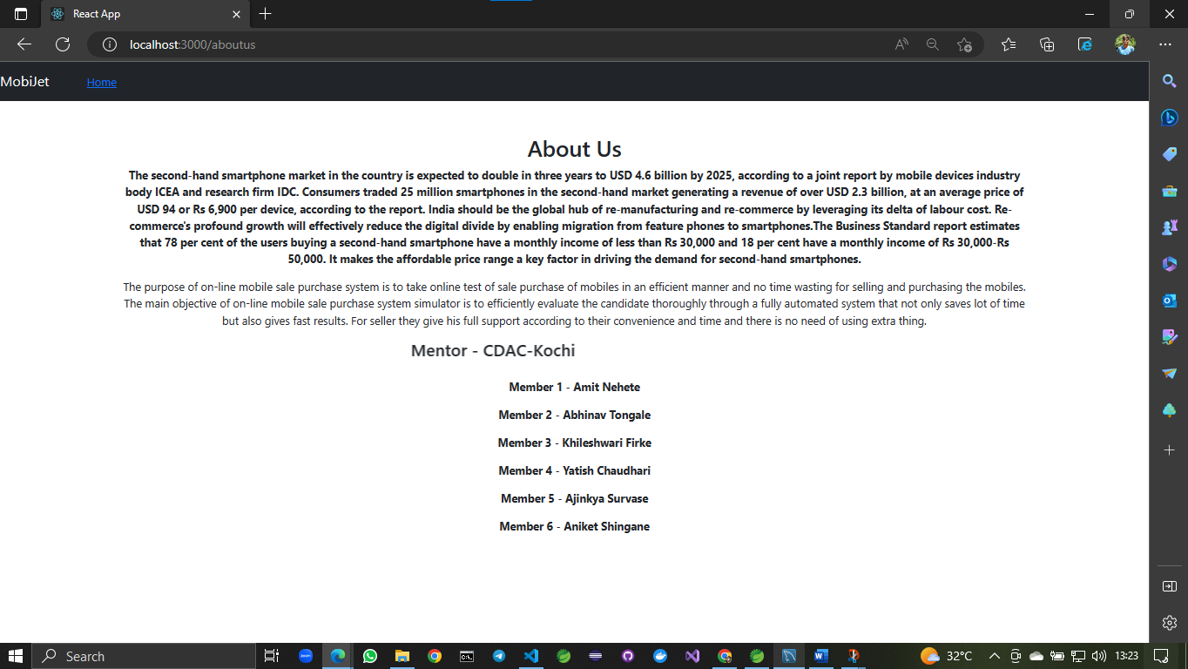
About Page

Slide 13
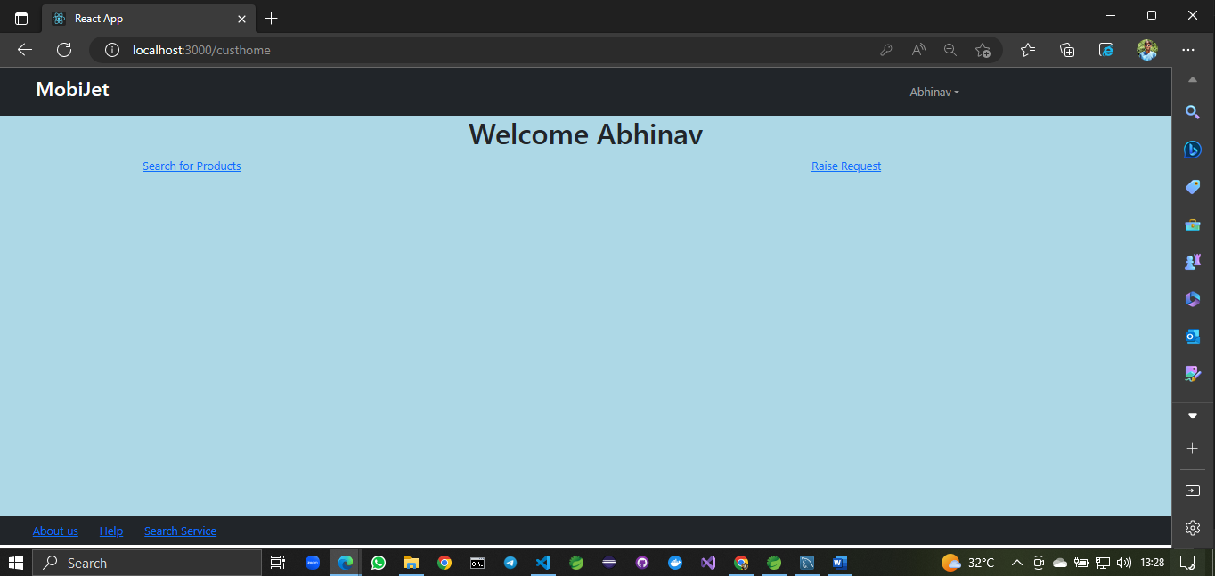
Coustomer Home

Slide 14
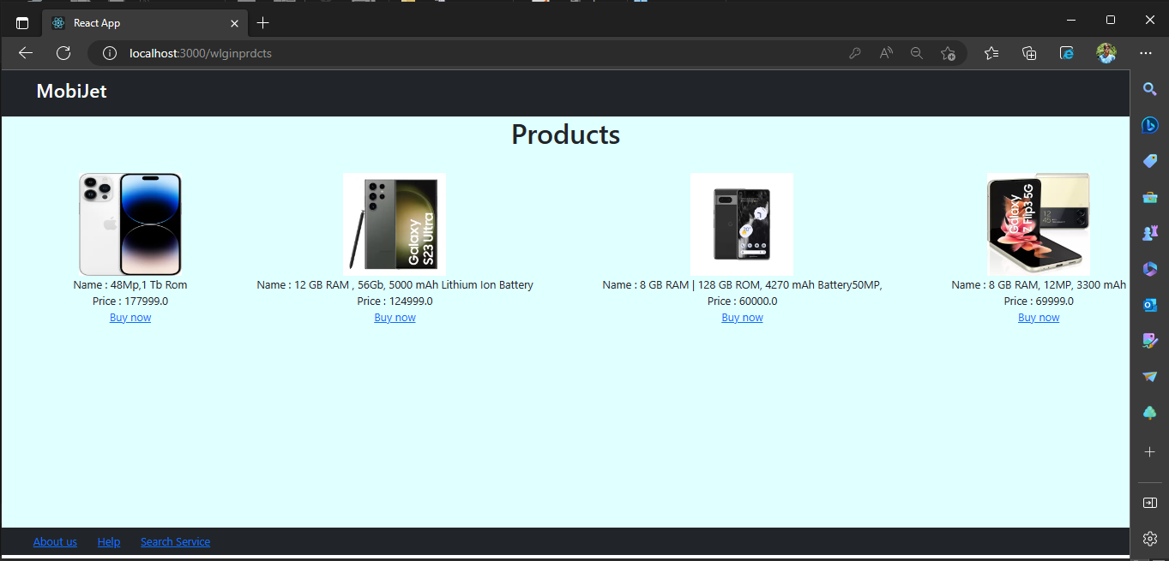
Customer can browse through all available products

Slide 15
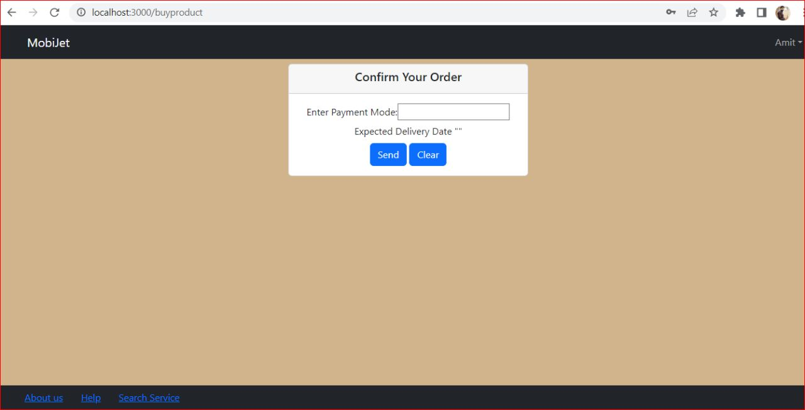
Buy now Products page

Slide 16
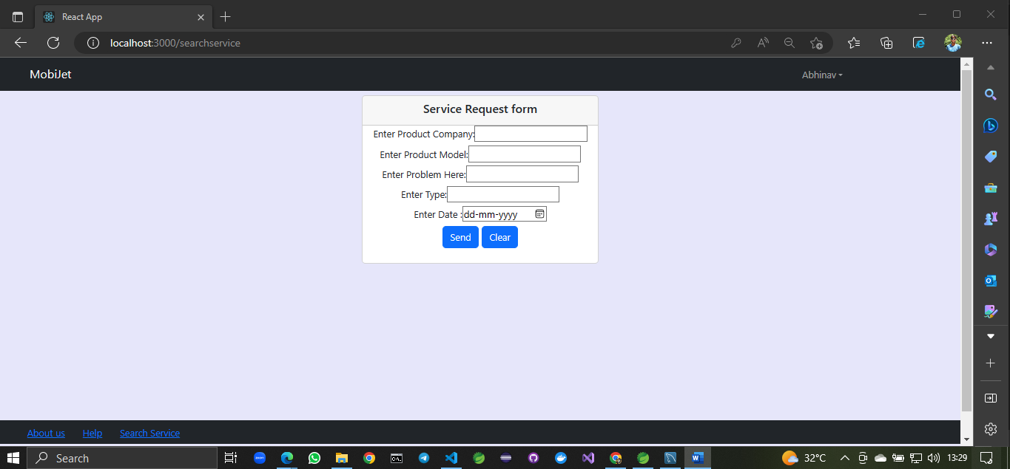
Customer can send request for service

Slide 17
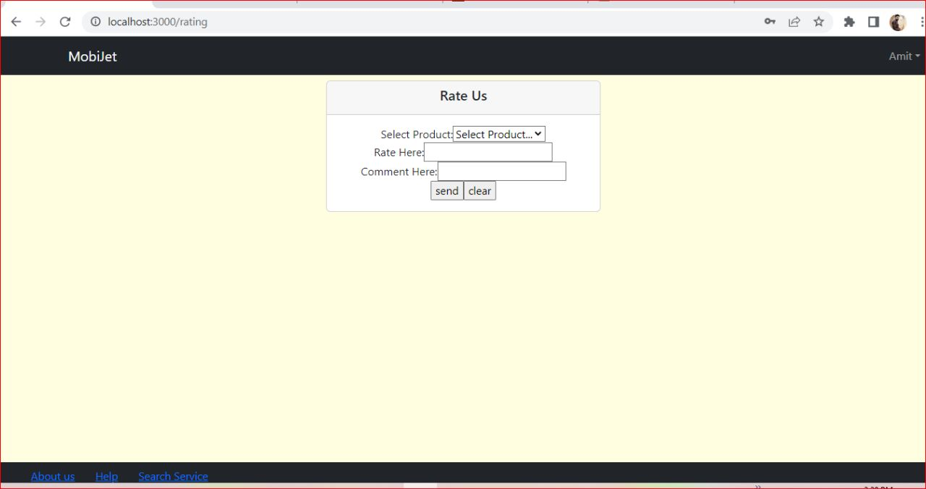
Rate us

Slide 18
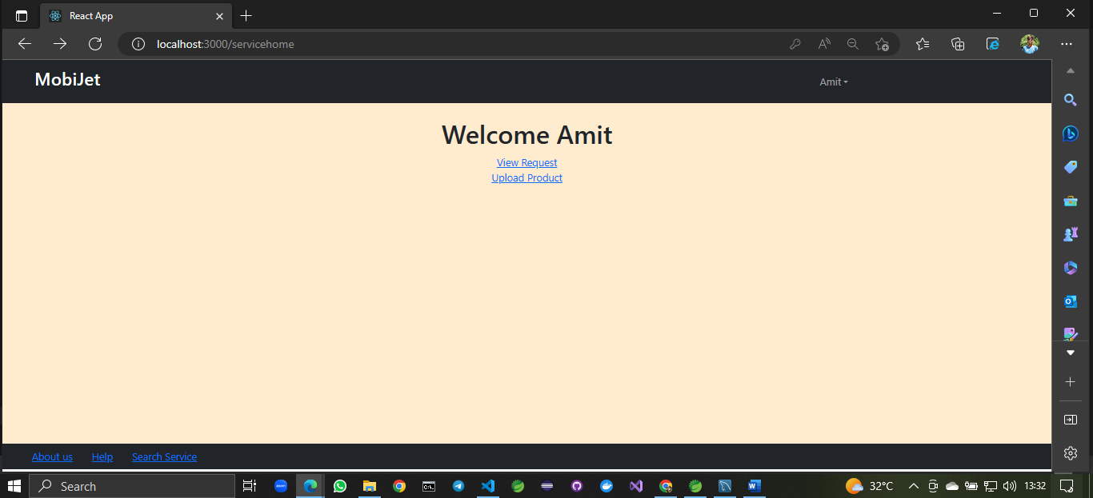
Service Provider Home

Slide 19
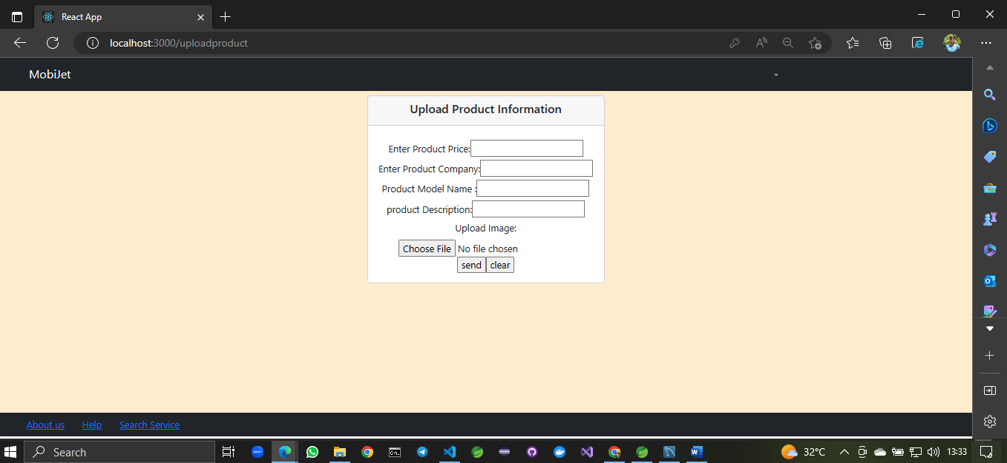
Upload product details by service provider

Slide 20
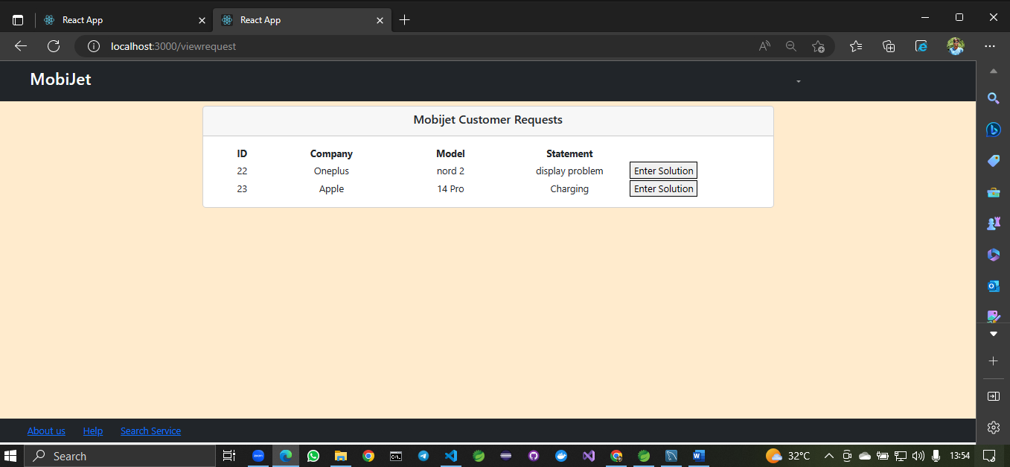
View all request for service send from customer

Slide 21
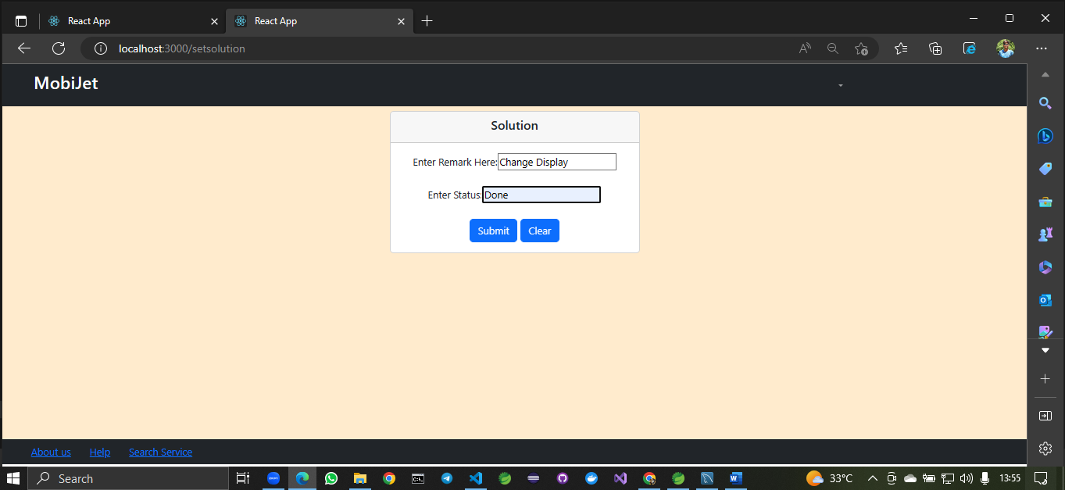
Enter solution of customer

Slide 22
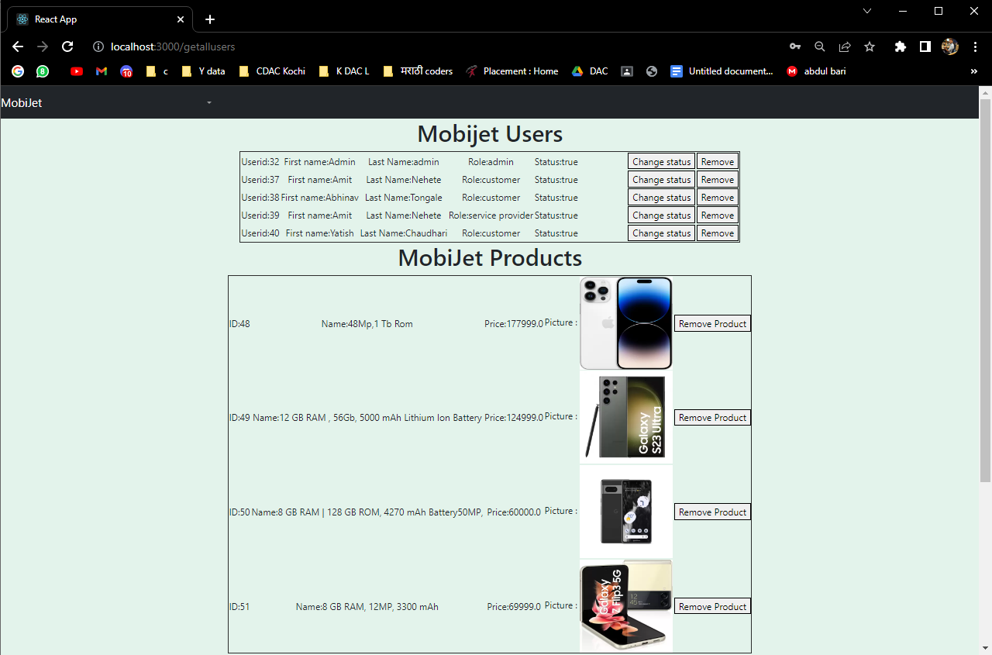
Admin

Slide 23
Points to be Upgraded :-
If we directly access any page inside customer or service provider then it is not redirecting to login page
Sorting according to price is absent
Discount coupons feature is given

Slide 24
Future Extension:-
If any product is short of its accessories and if customer requests then we will try to provide it.
Compare our price with new product price
We could extend this site with new mobiles and electronic gadget
Want to increase our service as many areas as we can
We can add cart page to buy 2 or more Product’s

Slide 25
Conclusion:-
MobiJet online system provide platform for customer and service provider to get connected with each other efficiently. Our system provides a user-friendly platform where customer can easily Buy-Sell and book appointment to take a mobile repairing services from Service Provider to solve their problems. Customer can also give feedback to the respective Products after buying it. Our system provides various verified second hand mobiles also repair services from respective area service provider. MobiJet is most efficient for customers, it is easy to use and can be handled by everyone.

Slide 26
Thank You!

